Slide 1
Organic Farming Bootcamp
Session 1
Sept 2, 2023

Slide 2
Agenda for Today
Introductions – 20 min
Bootcamp Overview – 5 min
A Trip down History – 30 min
Why Organic – 10 min
Farming Goals – 5 min
Today’s guest – 20 min

Slide 3
Introductions
Please turn on your video :-)
Your Name
Where you are based out of
What do you do
What do you want get out of the bootcamp
Notes:
Lets go around the room and introduce ourselves. Please introduce yourself quickly,

Slide 4
Bootcamp Overview
Live Sessions
Mini Projects – Farm Layout, Capex Plan, Crop Production Plan (with Rotation), Crop Enterprise Budget, Marketing Plan
Weekly Course Self-Learning Material Drops + Quizzes + Individual/Group Assignments

Slide 5

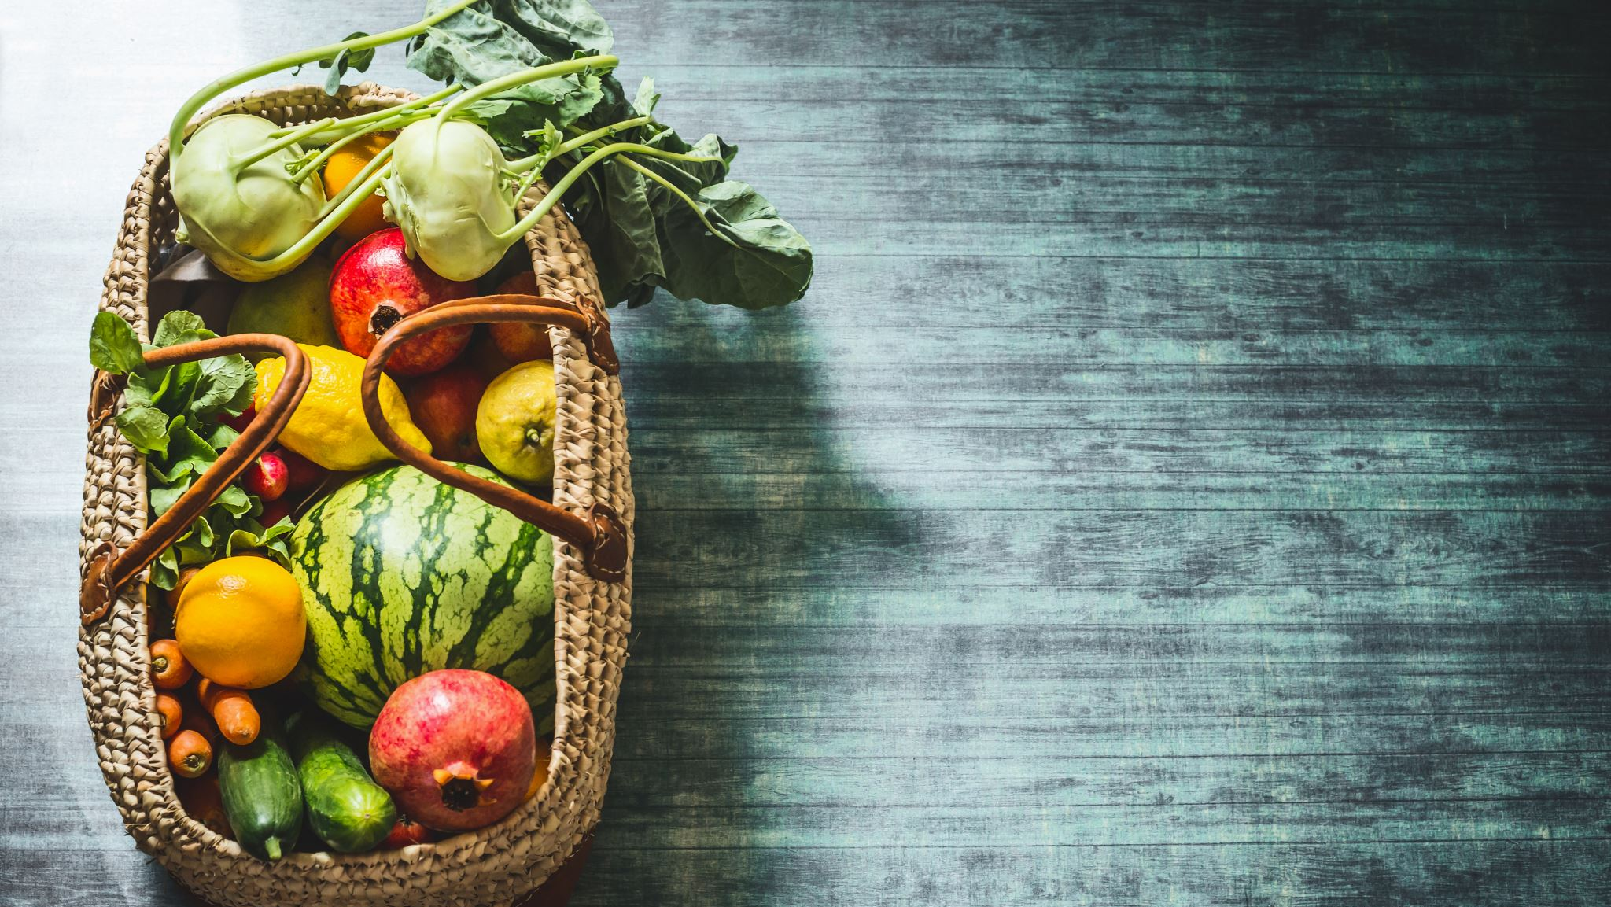

Why Organic

Slide 6
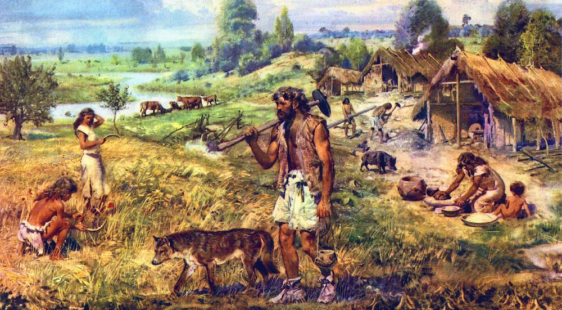
Notes:
First, lets do a whirwiind tour of history. It is generally agreed that villages or settlements existed well before agriculture, these were near good sources of water and food, like rivers where good dependable fishing could be had or near migration routes of animals

Slide 7
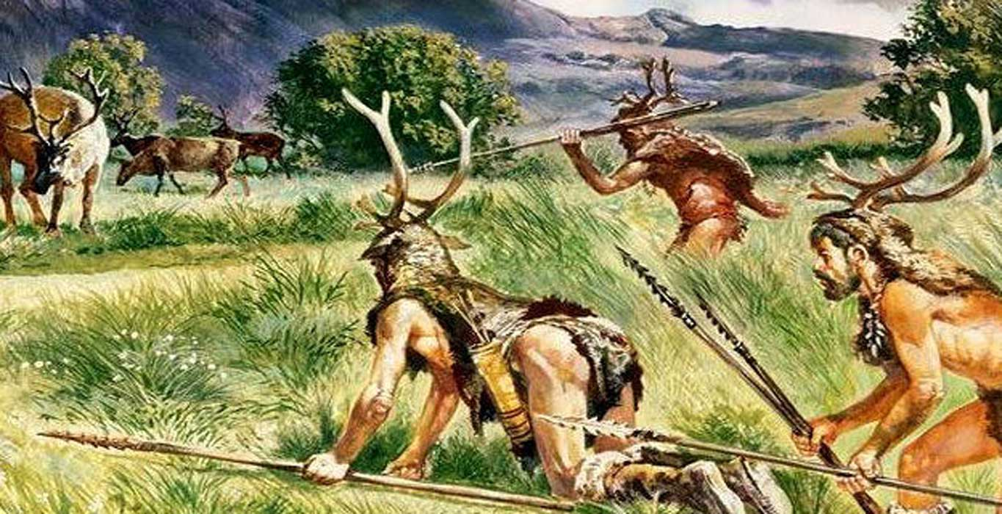
Notes:
The residents of these early settlements were still hunter gatherers

Slide 8
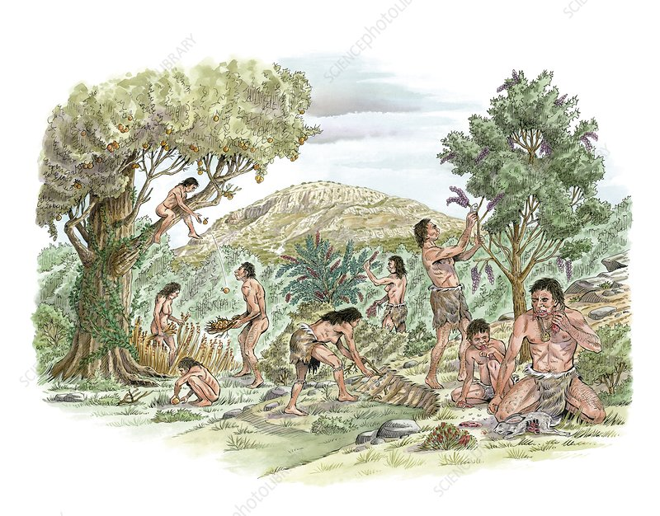
Notes:
Gathering included foraging for edible wild fruits, vegetables, berries and tubers

Slide 9
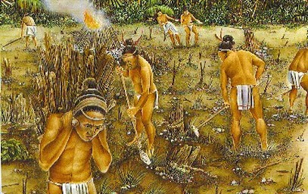
Notes:
Attempts at agriculture were gradual and sometimes by chance, Local ecosystems would be modified so that it supported more plants which we considered food , for examples cereals are grasses so forests or scrub land would be burnt so that more of these wild cereals grow

Slide 10
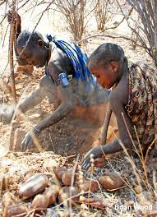
Notes:
Some food plants humans would help propagate, for example tubers were a big source of food, so when a large source was dug up some would be replanted in places suitable for growth

Slide 11
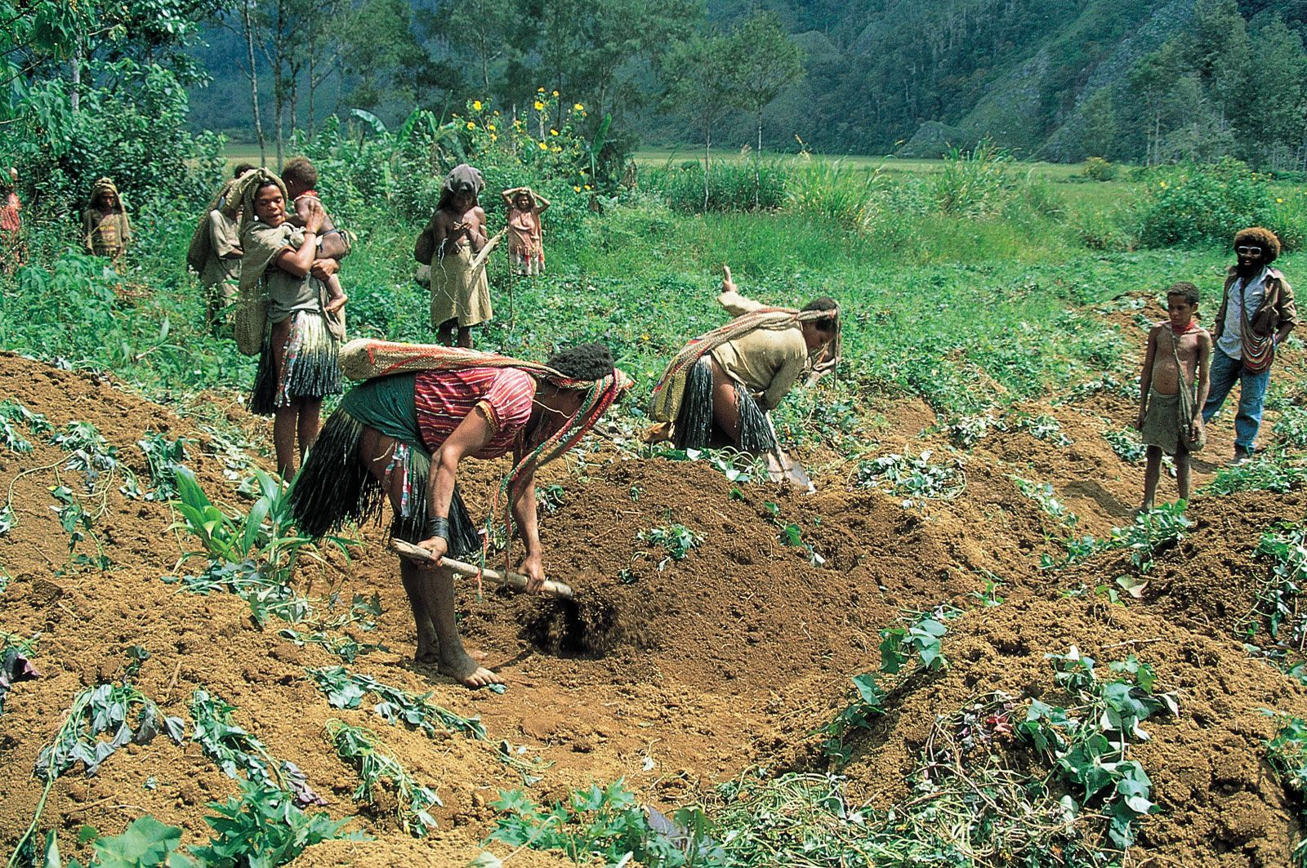
Notes:
Even today if you observe tribals, wild tubers are a big part of their diet

Slide 12
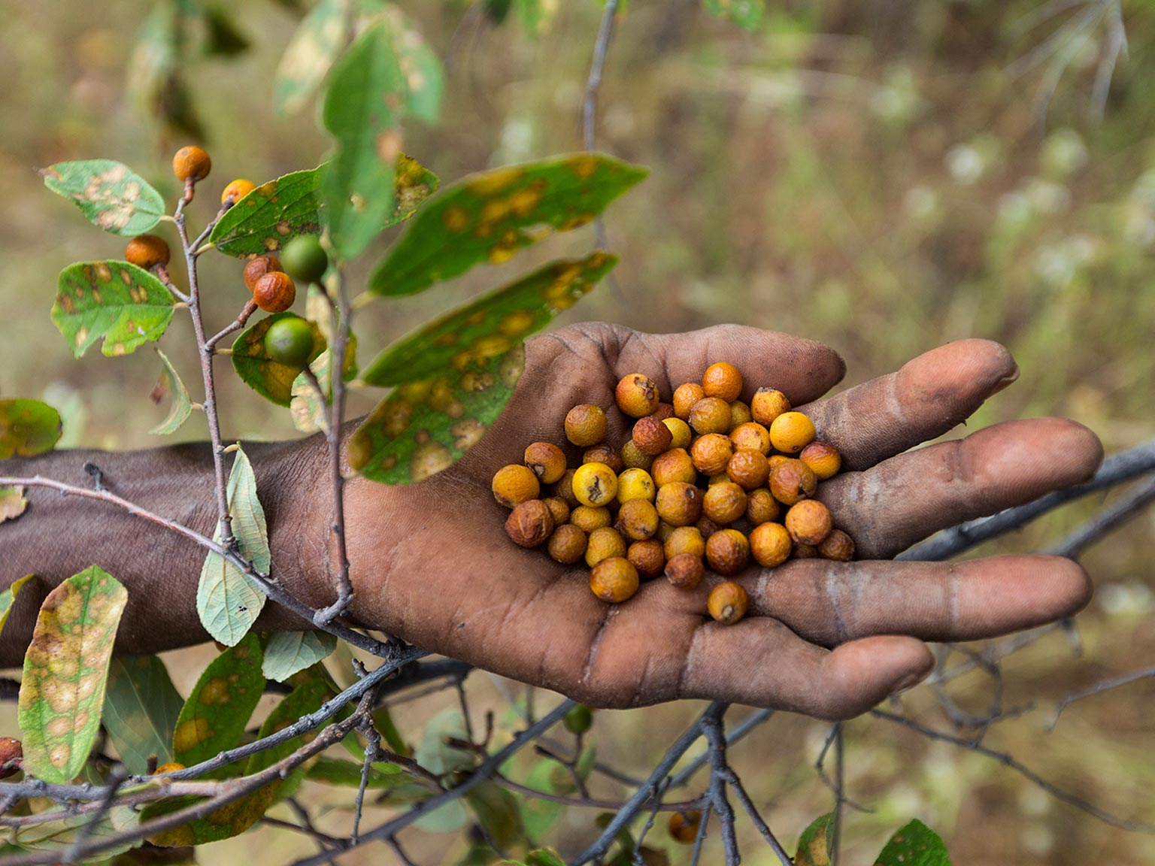
Notes:
Seeds of fruits would be planted at suitable places, when villages split or people in them migrated, they would even carry these and plant them in new areas. All these happened 8-10 thousand years ago

Slide 13
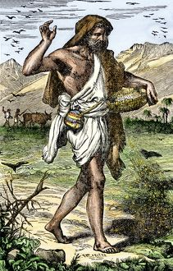
Notes:
Over time these small steps led to intentional agriculture.

Slide 14
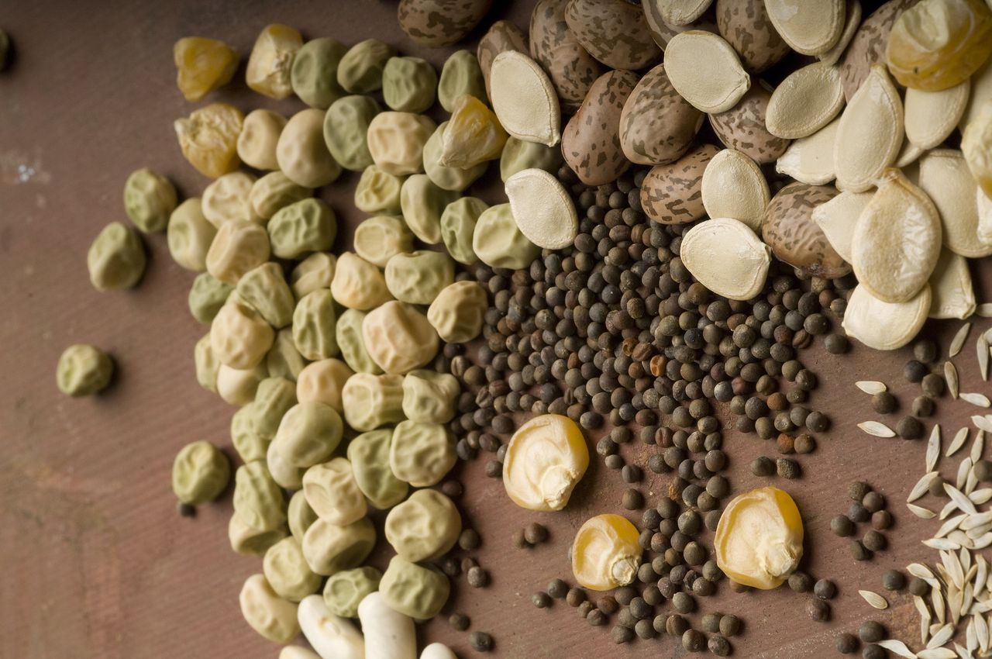
Notes:
Humans would save seeds of grains to resow before monsoon. Gradually they started selecting seeds from plants which gave a good yield,

Slide 15
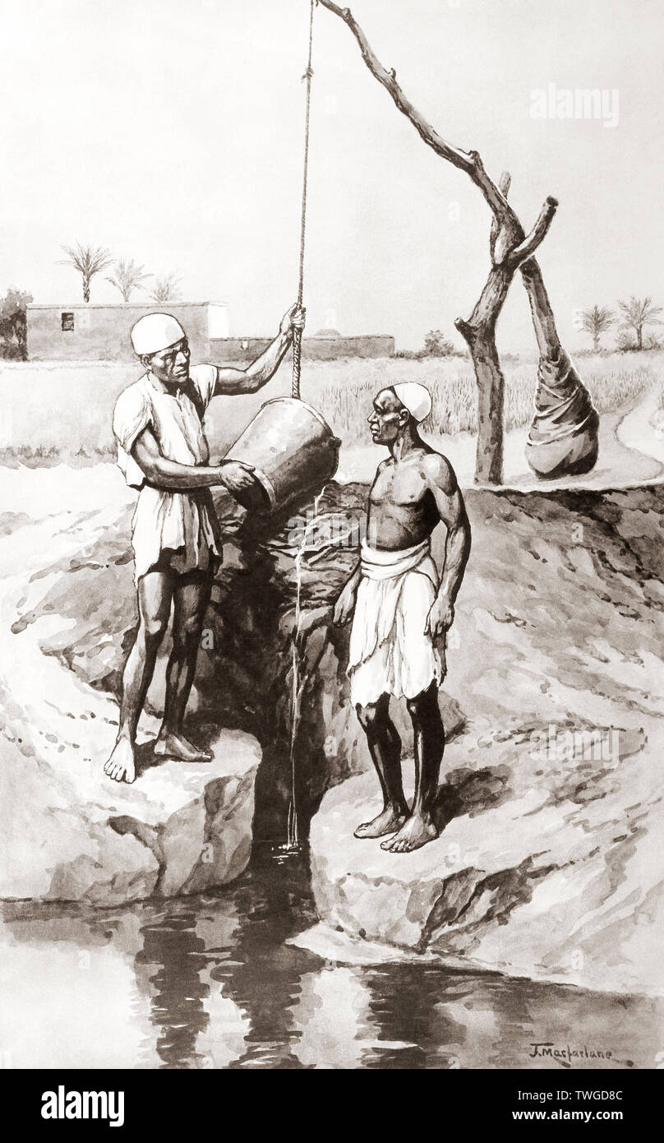
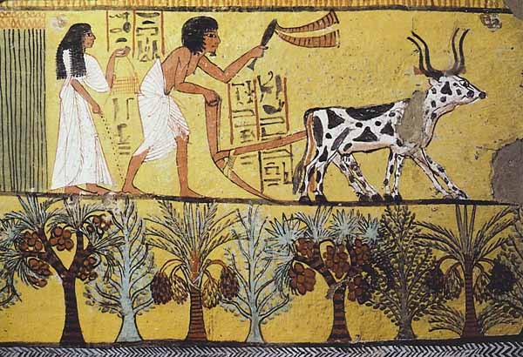
Notes:
Then came attempts at irrigation and ploughing etc, so INTENTIONALLY modifying the soil and creating conditions to grow one type of crop.

Slide 16
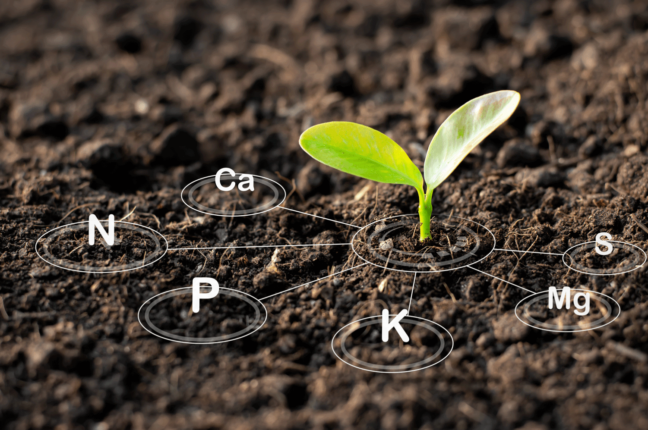
Notes:
One of the main things that was main problem with these early adopters of agriculture was soil fertility. Let's say this plant requires some nutrients to grow, with every crop harvested these nutrients would get depleted from soil, until a time comes when they are are completely depleted and would not support the crop. This is a very limited view of soil fertility, but for now, lets stay with this.

Slide 17

Notes:
So what did early farmers do to address this? At first, they did nothing ,

Slide 18
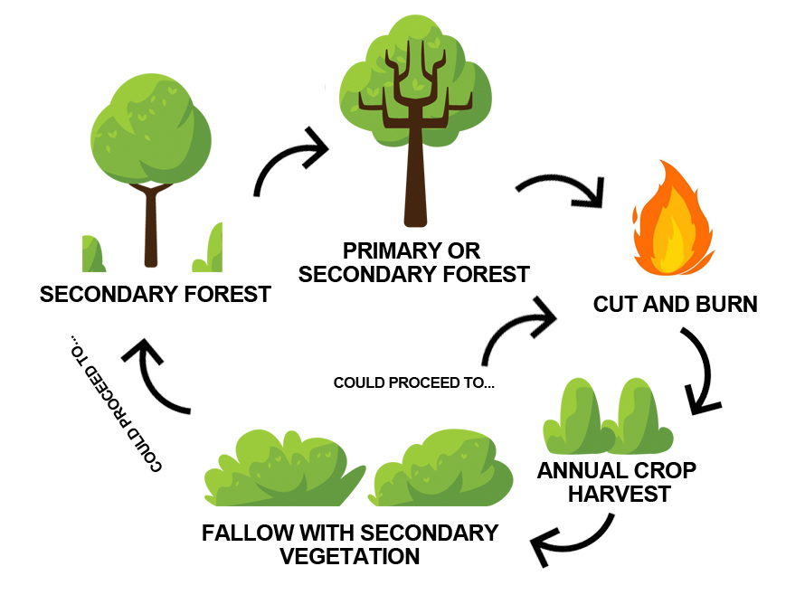
Notes:
They followed something called shifting agriculture. They just cleared another plot of land which was uncultivated and fertile, meanwhile the cultivated fallow land become fertile again thanks to natural processes , weeds and plants would grow again, decompose and add nutrients back to soil

Slide 19

Notes:
But shifting agriculture couldn't go on forever, land itself is finite source with the increase in population thanks to success of agricultural produce, this method couldn't go on forever. And one of fundamental thing about humans is to own things. So, someone must have observed land on which livestock was kralled regained fertility sooner, because of all the dung and urine.

Slide 20
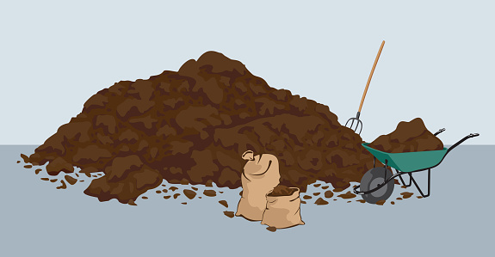
Notes:
So adding manure from various livestock became common way of adding some fertility back

Slide 21
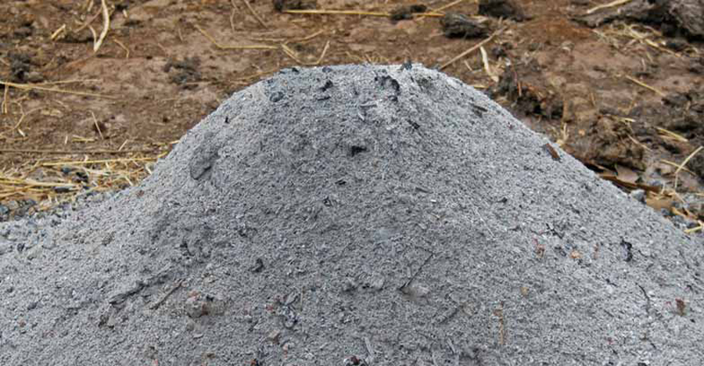
Notes:
Some started using wood ash to replenish the soil as this contained a lot of minerals, calcium and phosphorus.

Slide 22
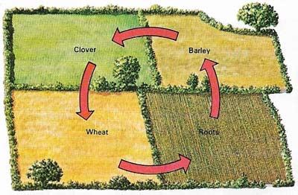
Notes:
Crop rotation was another method used, like growing a legume which added nitrogen to soil, and then using this nitrogen to grow a cereal and then growing a cover crop

Slide 23
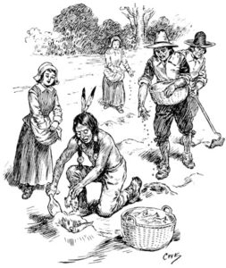
Notes:
Other odd ways include using dead animals as manure, Native indians actually taught the pilgrims how to grow crops using dead fish, that's how these pilgrims survived the first year in america

Slide 24
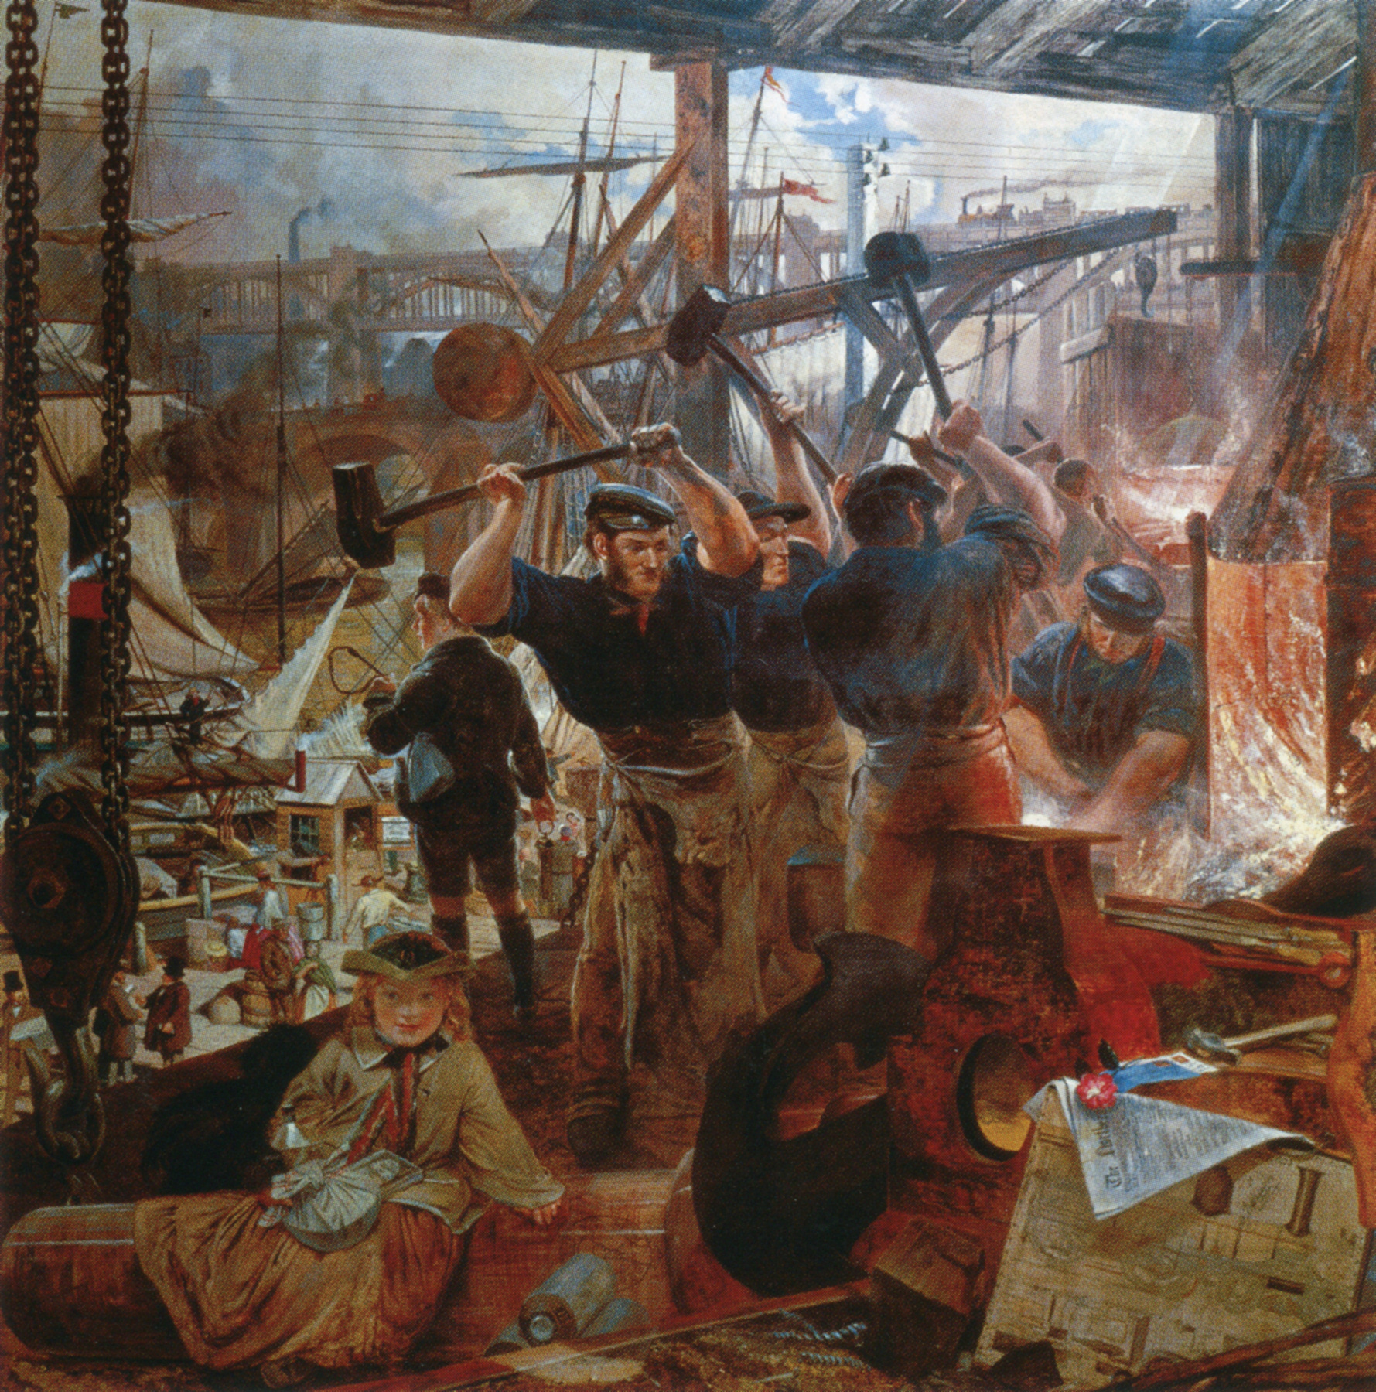
Notes:
Farming remained more or less the same till 18th century when industrial revolution started, more people were needed to work the factories and less number of farmers had to grow more food more quickly to feed them

Slide 25

Notes:
What made this possible was Guano which is sea bird shit (and also bat shit). It was one of the first commercially available fertilizer of the modern world, but the the inca civilization had grown on food using it . Very rich in Nitrogen, Potassium and Phosphorus.

Slide 26
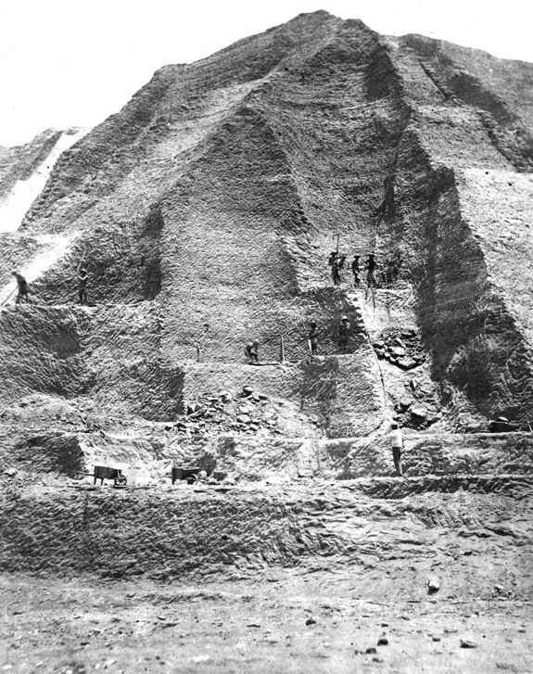
Notes:
Entire mountains of guano accumulated over centuries were mined and shipped to the modern world, countries would claim uninhabited islands for its guano

Slide 27

Notes:
But again it was a finite source and this white gold soon began running out, entire islands were dug up and shipped over thousands of miles and, it became so rare that at the fag end of its supply, a sack of this white gold started costing super high – hence the name white gold.

Slide 28
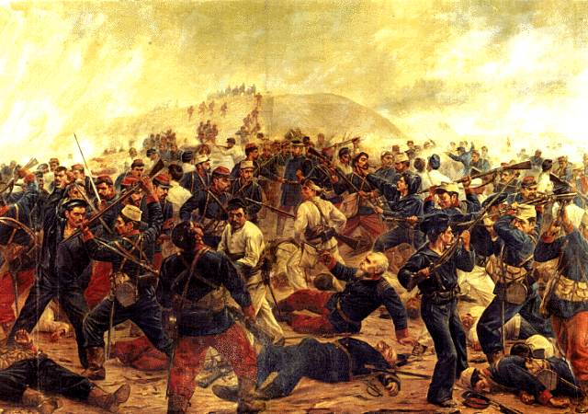
Notes:
The world was hooked onto Guano. So much that, in 1879, the Guano war that took 18,000 lives was fought over rights of these guano rich islands

Slide 29
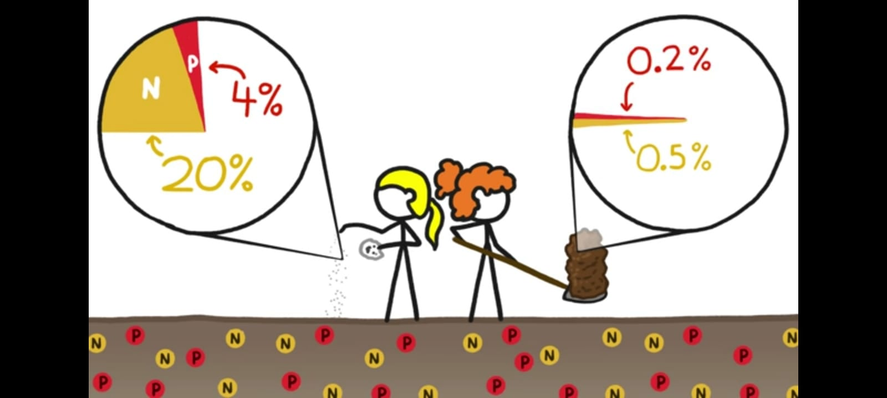
Notes:
But why did guano work so well? A fistfull of guano gave the same results as a bushel of manure.
Scientists had figured out by now that it was due to nitrogen and phosphorus content, 20% of guano was nitrite whereas in cow dung it was 0.5 %, so with dwindling supply and they had to figure out a way to synthesize this nitrogen

Slide 30
The Chemical Age
19th century
Von Liebig (father of the fertilizer industry) and Reductionism
NPK theory arrived at by analyzing dead plants (ash) instead of a living plant
Liebig’s realization towards the end of his life:
“I have sinned against the wisdom of the creator and received my righteous punishment. I wished to improve his work and in my blindness believed that, in the marvelous chain of laws binding life on earth’s surface and keeping it always new, a link had been forgotten which I weak and powerless worm must supply”
Notes:
Methodological reductionism is the position that the best scientific strategy is to attempt to reduce explanations to the smallest possible entities.
It all started with a BIG LIE
The fertilizer industry ignored Liebig’s admission and revision of his theories where he admitted that agriculture was complex and holistic approach was needed instead of a reductionist approach.

Slide 31
The Fertilizer Age
First World War
  Nitroglycerine bomb to blow up enemy tanks invented
  Results in development of economically viable process for fixing Nitrogen
Notes:
1913 Haber
1914 World War 1

Slide 32
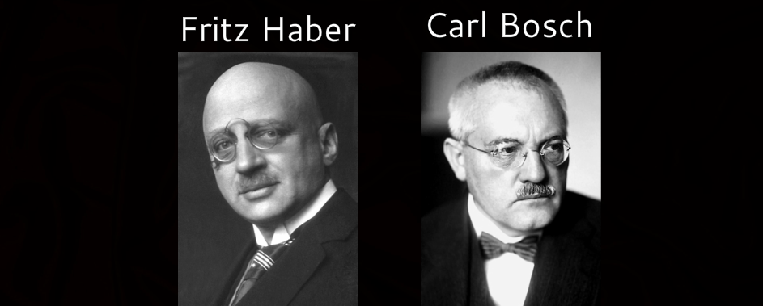

Slide 33
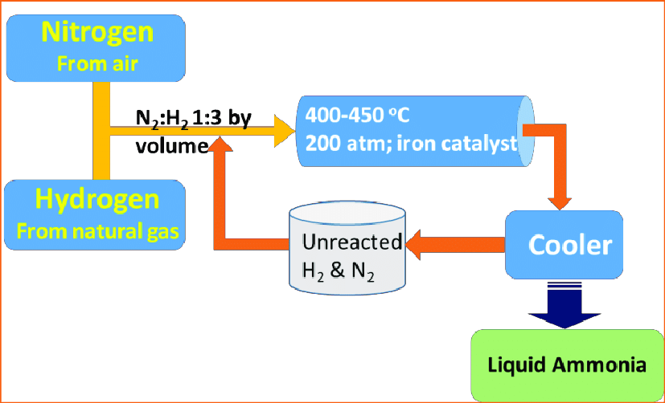

Slide 34
The Fertilizer Age
AFTER the war
  Huge stockpiles of Nitrogen based compounds
  Entrepreneurs find ways to use stockpiles for agriculture, using Liebig’s NPK theory

Slide 35
The Pesticide Age
Second World War
  Allied forces suffer more from Malaria, than from enemy guns
  Scientists found that an earlier discovered compound DDT had insecticidal properties and could kill mosquitos

Slide 36
The Pesticide Age
AFTER the war
  Huge stockpiles of DDT (organo-chlorine) after the war
  Extensive use of nitro-geneous fertilizers have by this time created weak plants prone to pest attacks
  Entrepreneurs find ways to use stockpiles for agricultural pests
  Pests develop resistance to DDT and the pesticides need to become more and more lethal
  Organophosphates capacity created for making nerve gas. Needed to find new use for these – pesticides !

Slide 37
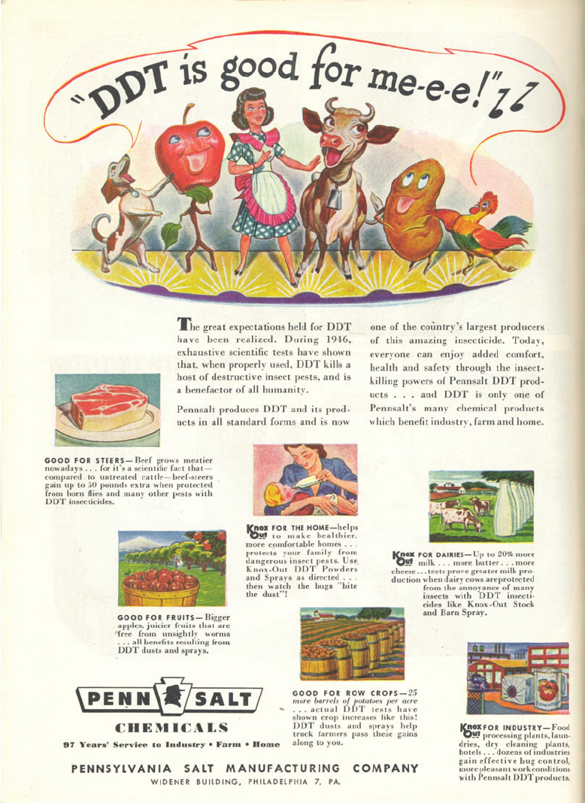

Slide 38
Alarm Bells
Rachel Carson
  Discovered that the beloved birds of her childhood had gone silent
  Her research highlighted the adverse effects of chemical pesticides on the bird population
  DDT was interfering with the calcium cycle making egg shells weak
  Wrote “Silent Spring” to alert the world

Slide 39
Indian Agriculture
Ancient Indian agriculture was super advanced, holistic, and based on observation of natural world – e.g. Vrikshayurveda – written 3000 years back
Disruptions & famines caused during British rule
  Time-tested farming practices ridiculed & labelled as superstitions
  Zamindari system broke the vital link between the farm and its true custodian
  Forced monoculture

Slide 40
Indian Agriculture
  Partition of Bengal and Punjab caused further disruption of agriculture and created artificial food shortages
  Green Revolution

Slide 41
Green Revolution
In the beginning
  Offered the Panacea of Urea/NPK/High Yield seeds
  Punjab soil organic carbon content was 4-4.5%
  Initial spectacular yields were obtained as it was using up the organic carbon percentage
TODAY
  Organic Carbon ~ 0.32% in Punjab – hence more and more fertilizers are required
  Ever increasing pest problem need more and more poisons
  Much of the fertile Punjab is now a cancer belt

Slide 42
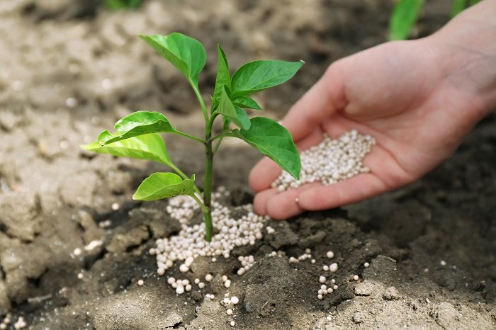
The Problem with Chemical Fertilizers
Notes:
Chemical fertilizers just replenish nitrogen, potassium and phosphorous. Soil fertility is much more than these three, there are lot of other nutrients and minerals which are not at all replenished by these.

Slide 43
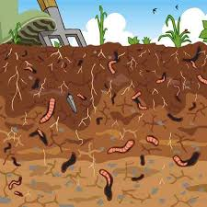
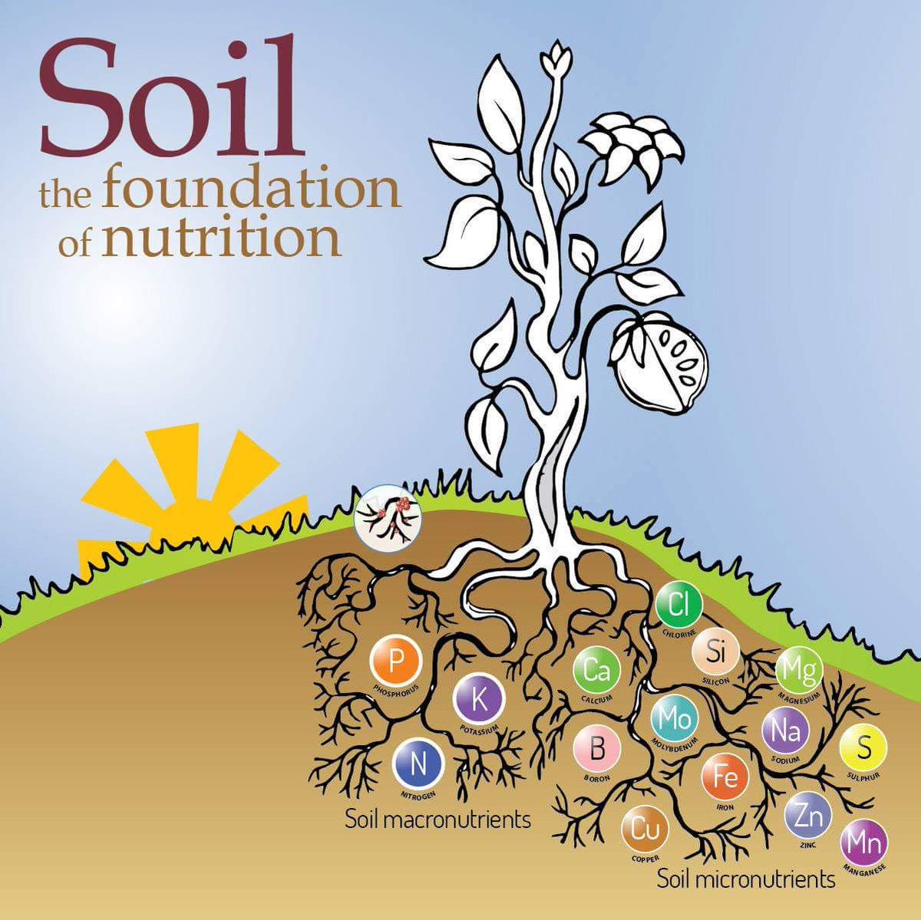
Notes:
And soil needs to be porous and soft and have a lot of organic matter, microbes and other small animals of the soil provide these.

Slide 44
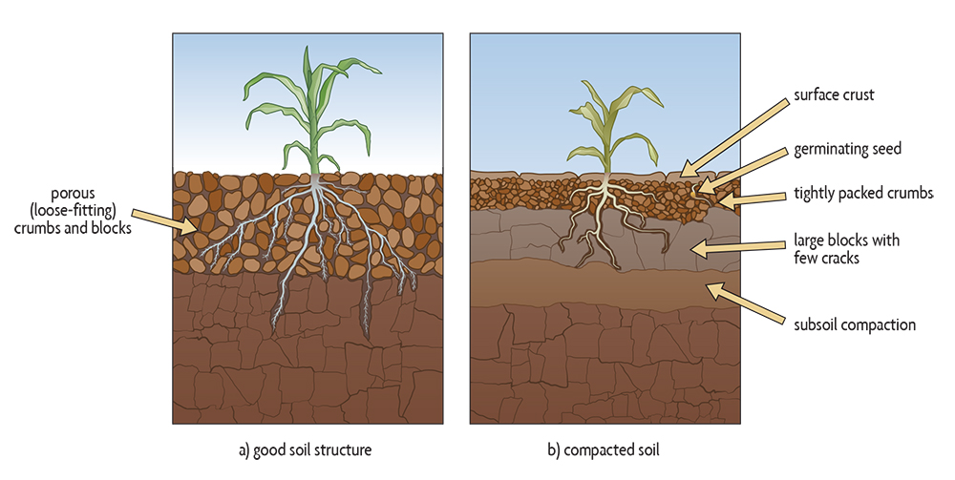
Notes:
Chemical fertilizers change the soil chemistry change its ph, this leads to soil crumbs loose their structure, when soil structure changes and becomes hard it no longer support the crops.

Slide 45
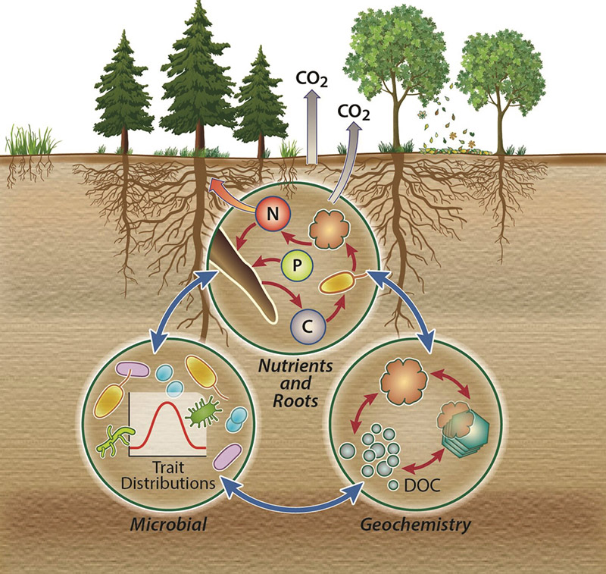
Notes:
Nor does it support soil microbes which convert a lot of nutrients into bioavailable form.

Slide 46
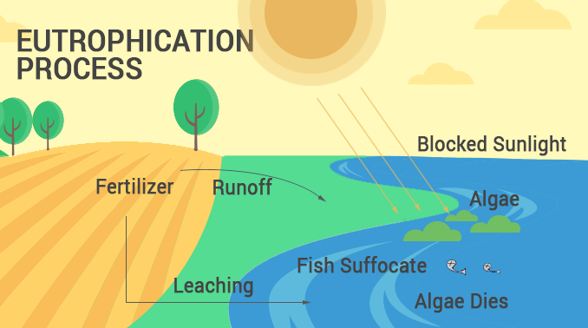
Notes:
Another issue is that not all of the applied fertilizer is used up by the crops. It is estimated that 40%–70% of the nitrogen, 80%–90% of the phosphorus, and 50%–70% of the potassium of the fertilizers applied is lost - it gets washed off into water bodies leading to blooming of algae, groundwater pollution et. These algal blooms increase methane emissions into the atmosphere.

Slide 47
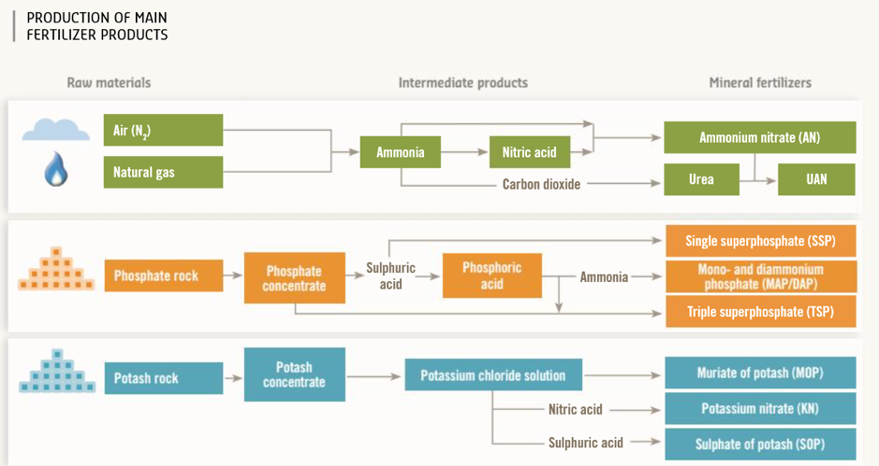
Notes:
Another issue is that chemical fertilizers are again a finite source like guano, fertilizer industry transforms millions of tons of air, natural gas and mined ores into fertilizers, both potassium and phosphorus fertilizer is made from mined ores

Slide 48
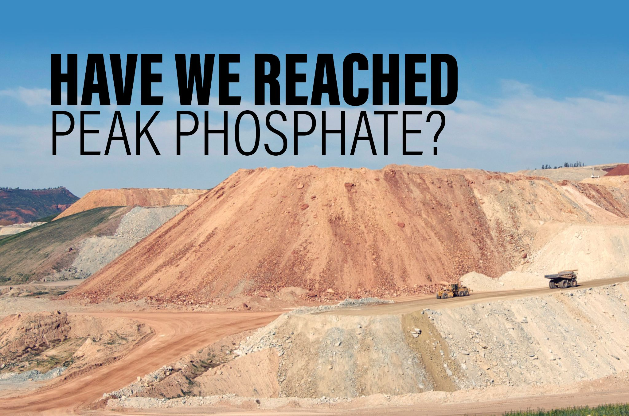
Notes:
Some of these ores have already reached their peak supplies. for example – some reports suggest 50% of reserves of phosphate have already been mined and used up. Agrochemicals lobby claims there is 300 years of rock phosphate left to mine.

Slide 49
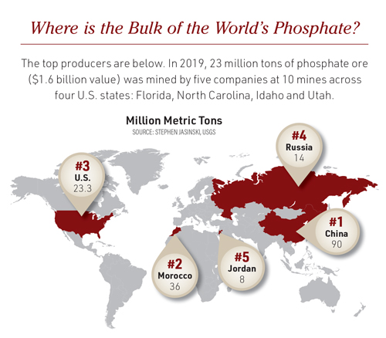
Notes:
For india, though, we don’t have much of these ores. And we need to import them anyway.
For India’s food security without relying on imports, moving into organic is a MUST.

Slide 50
OK – so we should grow organic. But why should consumers buy organic?
Most consumers associate organic with only no-pesticides. That is just a tip of the iceberg
As organic producers, we need to be able to communicate with consumers in terms that matter to them

Slide 51
1. Antioxidants
Organically grown crops are more prone to pest attacks than conventional crops
To defend against pests, they produce more of phenolic compounds called phyto-chemicals.
These act as antioxidants in humans, and neutralize free radicals in our body
Result: We get more of the anti-cancer, anti-ageing, immuno-modulation benefits of antioxidants
bit.ly/3mXctWw - research

Slide 52
2.Minerals
Organic farmers focus on building soil health with the help of soil organisms.
Cat-ion exchange capacity of root-hairs is higher in healthy soil.
Plants can absorb more mineral ions.
Eating organic produce gives us a good supply of trace minerals.

Slide 53
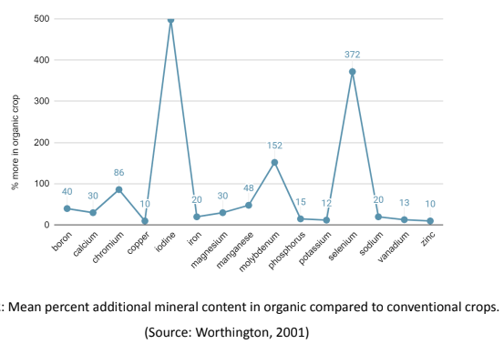

Slide 54
3. Toxic Heavy Metals
Conventional farming fertilisers are often made from industrial waste and can have heavy metals like Cadmium.
Heavy metals in our food can cause infertility, loss of memory, cancer, damage to nervous system.
Research - https://t.co/Mf12zVgufM

Slide 55
4. Excess Nitrates
Excessive use of nitrogenous fertilisers in conventional farming causes accumulation of excess nitrates in plants
Excess nitrates in our food can lead to endogenous nitrosation, causing diabetes, thyroid conditions, and cancer.
Research - bit.ly/3JP9vNx

Slide 56
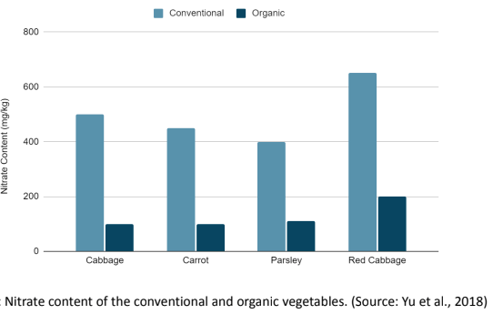

Slide 57
5. Pesticide Residues
Everyone understands this one.
Conventional farmers use both permitted and banned pesticides, sometimes just before harvest. These are dangerous chemicals you want to stay away from.
For example, organophosphates, the most popular type of pesticides, use the same biochemical mechanism as nerve gas. Pesticides like Mono-crotophos, banned in several countries, are widely used in India today. Anyone can buy and use them as they wish.

Slide 58
5. Pesticide Residues (contd.)
These dangerous chemicals invariably find their way on to our plates. often more than the maximum permissible limit.
Puts a lot of pressure on kidneys which work overtime to get rid of these toxins from our body.
Causes endocrine disruptions, cognitive impairment, lymphomas - the list is unending.
Problems are especially exacerbated in children, old or sick people, pregnant women.

Slide 59
A Better Way Of Growing Food
BETTER FOR CONSUMERS
BETTER FOR FARMERS
BETTER FOR THE PLANET

